Slide 1
Assignment 4 – Price Prediction
By Sriyaank Vadlamani

Slide 2

Review of EDA
Found that the price variable had very weak correlations with other numeric variables
Found relationship between the presence of crime and price
Found relationship between the room type and price
Found relationship between neighborhood and price

Slide 3


Since no numerical variables are highly correlated enough with price, I only have access to categorical variables
Thus, I will be using a decision tree to predict the price using the rpart library
Will also do hyperparameter tuning using the mlr library, and error analysis using the Metrics library

Slide 4

What variables to Use?

Slide 5
Variable #1: Distances from POI
In EDA, I found the Distance from the nearest POI wasn't useful for predicting price since there was no correlation between the two variables.
However, some POIs are more desirable than others and some aren't ideal to be near.
For instance, getting an Airbnb near JFK airport isn't ideal since it's noisy and far from other tourist locations.
In my experience, people in New York tend to like Broadway shows, so the distance from Broadway may also have an impact.
Lets include distance from JFK and distance from Broadway in the model.

Slide 6
Variable #2: Presence of Crime
EDA showed no correlation between crime rate and price
EDA showed correlation between the presence of crime and price
Will add column that indicates if there is a recorded crime rate near the Airbnb

Slide 7
Additional Variables
EDA showed correlation between neighborhood and price
Too many neighborhoods for our decision tree
Will use neighborhood group instead
EDA showed correlation between room type and price, so will use it

Slide 8
Analyses
For each model, I looked at feature importance to see how important variables were
Would’ve removed unimportant variables, but I didn’t need to do this
For error and performance analysis, I looked at the MAE and RMSE values of the model
MAE is less biased towards larger errors while RMSE highly penalizes large errors
Including both values to account for both ways of treating large errors
The lower the MAE and RMSE, the better the performance

Slide 9
Making decision trees

Slide 10
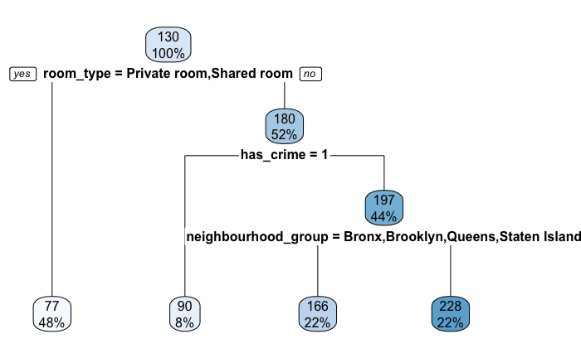
Test #1

Slide 11
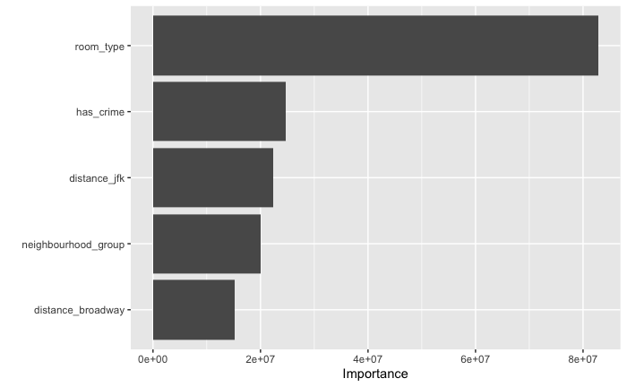
Test #1: Model Interpretation
Used all the variables mentioned to create the tree
Feature Importance listed all variables as very important, but room type as far more important than the others
Despite that, the tree didn’t end up using the distance from POI variables
Only 4 leaf nodes, depth of 3, and 3 splits
Not enough information

Slide 12
Test #1: Error & Performance analysis
MAE: 58.65155
RMSE: 182.5883
The error values are too high
Doesn’t perform well

Slide 13
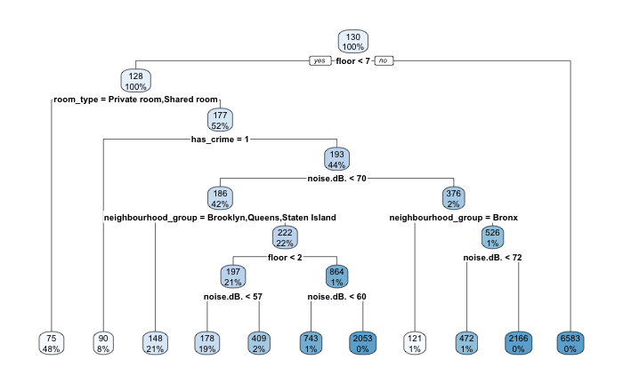
Test #2

Slide 14
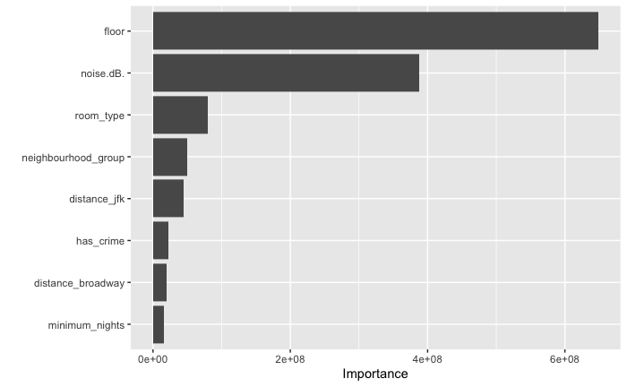
Test #2: Model Interpretation
Although none of the numerical variables correlated a lot with price, minimum nights, floor and noise(dB) correlated the most
Decided to include these in decision tree
This has a lot of leaf nodes (11) depth of 7, and 10 splits
Feature importance listed floor and noise (dB) as the most important features by a lot

Slide 15
Test #2: Error & performance analysis
MAE: 43.91276
RMSE: 105.5126
Values are better than before, but still kind of high
Will try hyperparameter tuning for maximum depth and complexity parameter
These two combined should result in the most optimal number of variables/splits

Slide 16
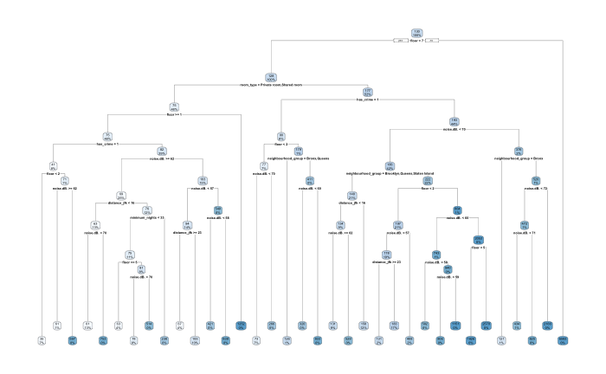
Test #3

Slide 17
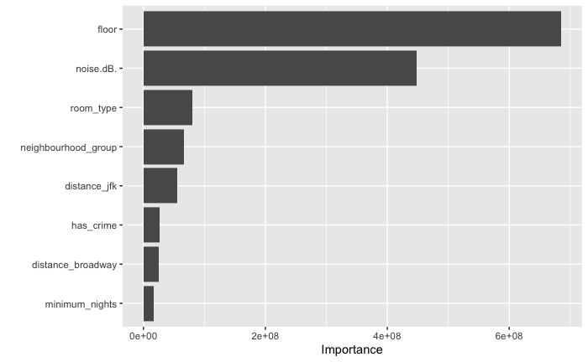
Test #3: Model Interpretation
Hyperparameter tuning determined 24 as the optimal max depth and 0.001 as the optimal complexity parameter for MAE and RMSE
Used these values and the same variables from test #2
Resulted in 35 nodes and 34 splits
Feature Importance same as test #2

Slide 18
Test #3: Error & Performance analysis
MAE: 36.35329
RMSE: 92.0964
This is far better than the first model
Given the large values of the price in the train data, these values should be sufficient for predicting prices of AirBnBs

